Slide 1

Welcome!
to the unVeiling of
the most innovative
snow removal product ever!
Brought to you by: Peter Masi, Frank Faraci, and Joe Faraci
Guest Presenters: Brian Harrington, Rick Harrington,
Bob Iaccino and Margaret Perrotta
Notes:
Pete – is a craftsman – his past work experiences give him the skillset to engineer and perfect this product
Frankie – is a salesman – his sheer energy and passion intrigue people into wanting to know more about this product
My uncle pino – created the first version of this product more than 35 years
Pete and Frankie – together are developing various inventions and obtaining necessary patents to then lease those patents for each product’s production
Bob – with 21 years experience in the financial markets, Bob has appeared live on CNBC, CNBC Asia, Bloomberg Television, CNN International, Fox Business News, and various networks in Canada, China and Japan. Bob continues to appear 2-3 times weekly commenting on various economic, political and market-based topics. Bob has been a Principal and member of the investment committee for a Fund of Funds, and has run his own commodity pool. He was a member of both the Chicago Board of Trade and the Chicago Mercantile exchange from 1997-2003. He has consulted on multiple investments and startups. Bob currently serves as the Chief Market Strategist for Tethys Partners, a physical oil company based in the West Loop in Chicago, where he trades Energy.
Some of you may recognize the Harrington name. Kevin Harrington is well known for his appearance as one of the original Sharks on Shark Tank and as the Ambassador of As Seen on TV and is responsible for the development of the Infomercial industry.
Yes, Rick is Kevin’s cousin and Brian is Kevin’s son. They have worked together in their past endeavors and we are excited to have their expert support.
Rick Harrington – has 30 years of experience in the area of product development, started his career in the Toy Industry, and was involved in the development of many well known product lines including Star Wars, Indiana Jones, Care Bears, DC Comics, Thomas the Tank Engine, TMNT, GI JOE, and Glade Air Fresheners, Tide, Downy, Swiffer, GE appliances, P&G household products. Rick and his company Invurgency facilitate conceptual design development, product prototyping, and production.
Brian – is an entrepreneur who grew up in the Electronic Retailing Marketing Industry, while employed at AsSeenOnTV Inc. Brian was trained to learn all aspects of the industry including commercial production, product development, web sales and retail sales. He has been involved in dozens of product launches reaching sales of nearly $100 million. Brian served at the VP of Merchandising at AsSeenOnTV, where he was responsible for identifying, sourcing, and developing new products for commercial marketing success. He managed over 1,000 vendors, thousands of products, millions of customers, marketing strategies, content production, and team management.
Brian founded TeleStar Products International, Inc., a full-service electronic retailing marketing company, specializing in product development and identifying products strengths/abilities and their suitability for direct response and live shopping. TeleStar currently has dozens of products in-house, where they are working on sales and marketing programs for live shopping channels, direct response television, online, and brick and mortar retail in many different categories including kitchen and food, beauty, jewelry, fitness, personal care, nutrition, weight loss, and more.
Brian founded StarShop with his father Kevin Harrington, which is a joint venture with Sprint Corp that is a mobile shopping platform utilizing celebrities to sell product via unique selling videos. StarShop will launch in mid 2016 with hundreds of celebrities and thousands of products.

Slide 2
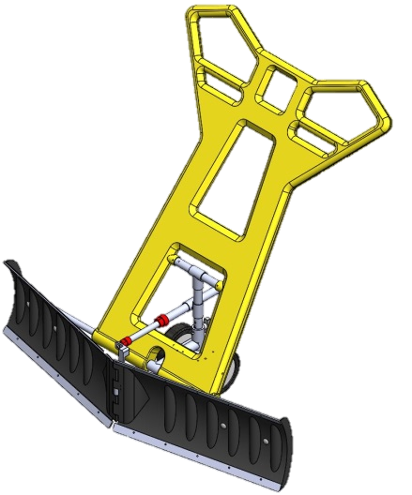
Cold Weather Snow Shoveling and the Risk for Injury
On average, every year, more than 11,000 adults and children go to the hospital due to snow shoveling injuries.
Chilling effect of cold weather on the heart
“Sudden exertion activities in cold weather can trigger a heart attack... ”
~ Cardiologist Grace Cater, MD.
http://www.metrohealth.org/shoveling-and-your-risk-for-heart-attack.
The Metro Health System. February 27, 2015.
Notes:
Margaret Speaking:
As most of us here are well aware from our own experiences, removing snow is a difficult exercise. The task sends on average every year, more than 11,000 adults and children to the hospital per a 2011 report from WebMD. In fact, a recent article on MetroHealth.org confirms that “Sudden exertion activities in cold weather can trigger a heart attack... ”
Yet, the basic snow shovel hasn't changed much since it was invented over 100 years ago. Handgrips are often lacking, and the shovel length typically is too short for most users. Steel shovels are heavy. The inefficient, non-ergonomic design of a shovel forces users to bend and twist while heaving snow, raising the risk for spine injury. With that said, it is prime time for a new snow removal product. please welcome Frankie to share more.

Slide 3

Welcome Friends and Family
Notes:
Frankie speaking

Slide 4

How it all started…
Joe Faraci’s old wood snow pusher
A casual conversation with Peter Masi
Peter’s engineering
Creation of the Mighty Joe
Further development of Mighty Joe into
Notes:
Frankie speaking

Slide 5
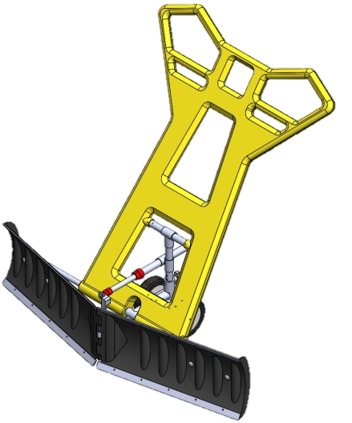
What is SnowViper?
It is an adjustable snow removal product that will push snow forward in a conventional manner.
This unique, safe, durable, efficient & lightweight product will change how snow is removed from driveways and sidewalks.
Patents pending and one obtained.
Notes:
Frankie speaking

Slide 6
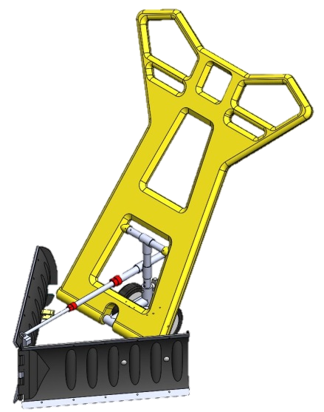
Two Adjustable Blades
Convert easily from a straight setting to numerous “V” configurations (from 30”- 48” wide)
Remove snow from driveways and sidewalks of various widths
Provide greater surface coverage
Can clear the snow from the average two car driveway in 5 passes and a sidewalk in 1 pass
Notes:
Frankie speaking

Slide 7
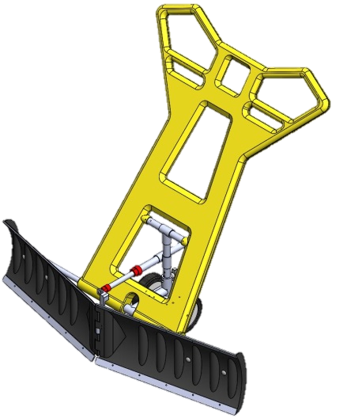
Ladder Frame Handle
Heavy duty and lightweight
Adjustable for the comfort of users of different heights
Notes:
Frankie speaking

Slide 8
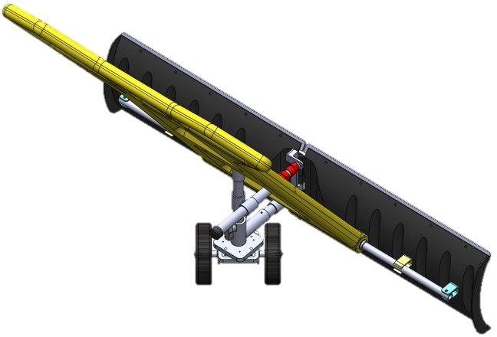
Handle Design and Swivel Wheels
  Allow the consumer to
  walk forward with SnowViper
  as the snow is pushed to the side,
  eliminating the need to twist/torque your body
Notes:
Frankie speaking

Slide 9

Wheels Extend from the Rear of the Blade
  Give consumers
  the ultimate comfort and confidence
  to push snow with ease
  without the physical challenges of lifting the snow.
Notes:
Frankie speaking

Slide 10
SnowViper Characteristics
Ergonomically Designed and Environmentally Friendly
Glides along the ground
Pushes the snow quickly and easily
Eliminates the need for heavy lifting
Reduces physical strain on the back and heart
Stores away quickly and easily, flush to the wall
Saves time, energy, fuel, & money!
Notes:
Frankie speaking

Slide 11
Market Analysis – Existing Products
Nothing exists that measures to SnowViper’s key features
Existing products with a couple similar characteristics range from $40 - $90 with a few priced over $100.
  None of these will clear snow as quickly and easily as the SnowViper.
Notes:
Margaret Speaking
With help from Rick Harrington, we leveraged an outside firm to do the market analysis for handheld snow removal products.
They confirmed that nothing exists that measures to the SnowViper’s key features.
Yes there are a variety of "snow pushers“ and these existing products range in price from $40-90 with a few priced over $100
But none of these will clear snow as quickly and easily as the SnowViper.

Slide 12

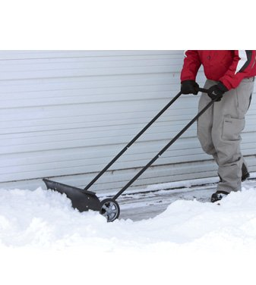
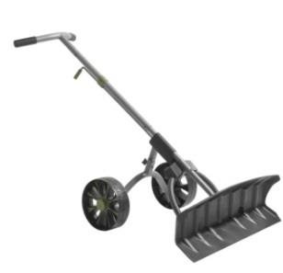
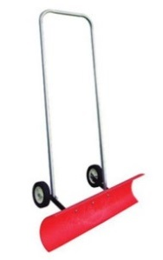
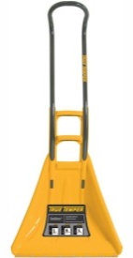
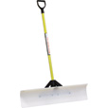

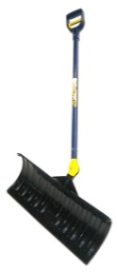
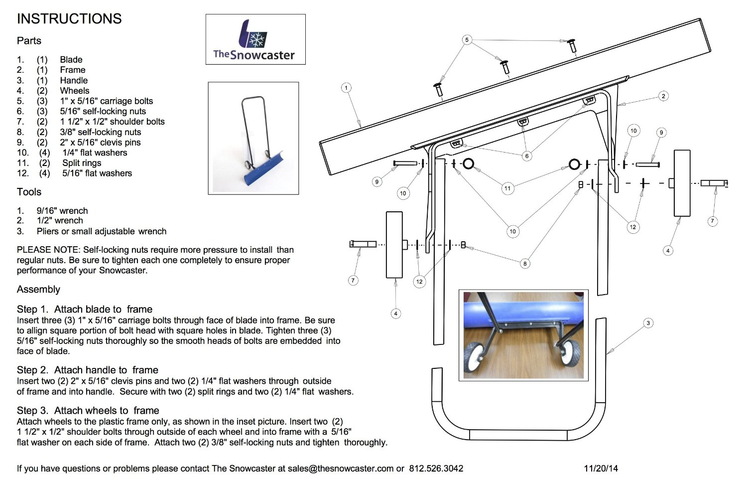
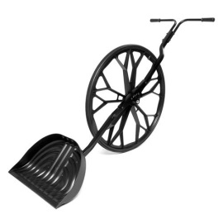
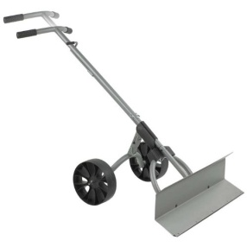
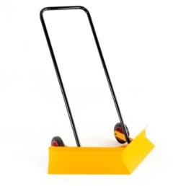
Other Existing Products
30" SnoDozer
$129.88
17 reviews - 4 stars
Amazon
The Snow Pusher 36"
$54.99
14 reviews - 5 stars
Northern Tool
Reinforced fiberglass
Dakota Sno Blade
$100.00
Hi Consumption.com
True-Temper-One-piece-Ergonomic-Aluminum
$52.56
160 reviews - 4 stars
Amazon
Wheeled Shovel
$39.99
29 reviews - 4 stars
Amazon
The Snowcaster
36" Bi-Directional
Wheeled Snow Pusher
$73.48
114 reviews - 4.5 stars
Amazon
The Snow Wolf
$159.99
375 reviews - 4 stars
Amazon
Power Dynamics Sno Dozer
$67.88 - Sale
18 reviews - 3 stars
Amazon
SWIVEL SNOW SHOVEL
3-WAY ACTION
CANADA
V Blade Snow Plough
ENGLAND
Notes:
Margaret Speaking
Here are some of the existing "snow pushers"
Some have wheels, some allow you to angle the blade, some are fixed position blades. Nothing exists with an adjustable blade. Nor did we find any products with the combination of characteristics that the SnowViper offers.
It is the combination of features that set the SnowViper apart from its perceived competitors.
At this point you’re probably wondering what the SnowViper’s projected retail price is. We are projecting it to be between $79 and $99.

Slide 13

State | Number of Households | Average yearly Snowfall in Inches
New York | 7,114,431 | 123.8
Wyoming | 204,935 | 91.4
Vermont | 248,825 | 81.2
Alaska | 233,252 | 74.5
West Virginia | 740,702 | 62
Maine | 542,158 | 61.8
New Hampshire | 497,054 | 60.8
Utah | 791,929 | 56.2
Minnesota | 2,020,144 | 54
North Dakota | 270,437 | 51.2
Michigan | 3,887,994 | 51.1
Wisconsin | 2,219,571 | 50.9
South Dakota | 310,331 | 43.9
Massachusetts | 2,448,032 | 43.8
Connecticut | 1,323,838 | 40.5
Montana | 368,268 | 38.1
Iowa | 1,200,833 | 34.9
Rhode Island | 406,089 | 33.8
Pennsylvania | 4,860,140 | 28.2
Ohio | 4,507,821 | 27.5
Indiana | 2,443,010 | 25.9
Nebraska | 695,592 | 25.9
Illinois | 4,691,020 | 24.6
Nevada | 906,719 | 21.8
Delaware | 317,640 | 20.2
Maryland | 2,085,647 | 20.2
Idaho | 532,135 | 19.2
Colorado | 1,819,037 | 19.1
Missouri | 2,285,280 | 17
New Jersey | 3,141,956 | 16.5
Kansas | 1,071,938 | 14.7
Kentucky | 1,653,898 | 12.5
Virginia | 2,889,688 | 10.3
Alabama | 1,788,692 | 1.6
California | 12,097,894 | 0
State | Index
New York | 881
Michigan | 199
Pennsylvania | 137
Ohio | 124
Illinois | 115
Wisconsin | 113
Minnesota | 109
Massachusetts | 107
Indiana | 63
Connecticut | 54
New Jersey | 52
West Virginia | 46
Utah | 45
Maryland | 42
Iowa | 42
Missouri | 39
Colorado | 35
Maine | 34
New Hampshire | 30
Virginia | 30
Kentucky | 21
Vermont | 20
Nevada | 20
Wyoming | 19
Nebraska | 18
Alaska | 17
Kansas | 16
Montana | 14
North Dakota | 14
Rhode Island | 14
South Dakota | 14
Idaho | 10
Delaware | 6
Alabama | 3
California | -
Information compiled from the United States Census Bureau and the National Climatic Data Center . which collected snowfall totals from 1981 to 2010 for one city from each state to represent snowfall in that state.
Notes:
Margaret Speaking
Let’s take a minute to look at snowfall across the US. We acknowledge that the amount of snow that normally falls varies widely from year to year. This data is based on snowfall totals from 1981 to 2010 for one city within each state to represent snowfall in that state. There are about 73 million households in the US that have an average yearly snowfall of at least 10”.
This Index factors in each state’s population and its average amount of snowfall. With the index we can see the top states are NY, Michigan, Pennsylvania, Ohio, Illinois, Wisconsin, Minnesota, and Massachusetts. Not only do these states receive a significant amount of snowfall, they are also highly populated. These are states for us to target.

Slide 14
Potential Consumer Base
Households
There are about 73,000,000 households in the United States with an average yearly snowfall of at least 10“.
~ United States Census Bureau and the National Climatic Data Center
Stores & Restaurants with outside entrances
Public Buildings
  Schools
  Hospitals
  Churches
  Museums
Notes:
Margaret Speaking
So who is our potential consumer base? From the previous slide, we saw that about 73 million households in the US have an average yearly snowfall of at least 10”. Also consider that there are more than 76 million baby boomers in the US. The consumer base for SnowViper is huge. We are especially excited to also note that according to Forbes, recent studies have shown that baby boomers are among the biggest buyers of new technology, 116 million US consumers age 50 and older spent $2.9 trillion in 2012. (http://info.4imprint.com/wp-content/uploads/1P-19-1013-Marketing-to-Baby-Boomers2.pdf. According to Forbes®)
We recognize that SnowViper is a key product for households and anyone maintaining the entrance of a building or outdoor location with visitors also benefits from having a SnowViper.

Slide 15
Product Development Process
Conceptual/Industrial Design
  Brainstorming – features and functions
  Form, Fit, Function - ergonomics
Mechanical Engineering
  3D CAD Modeling
  Component breakdown - Manufactured & Purchased
Electrical Engineering/PCB Design
Prototype - Functional & Presentable
Notes:
Rick Speaking

Slide 16
Product Development Process
Manufacturing
  Sourcing
  QC
  Process
    Tooling Startup – Method – Assembly
Supply Chain Management
  Shipping – Warehousing - Fulfillment
Graphic Design
  Logo – Branding Elements
Package Design
Market Analysis
Notes:
Rick Speaking

Slide 17
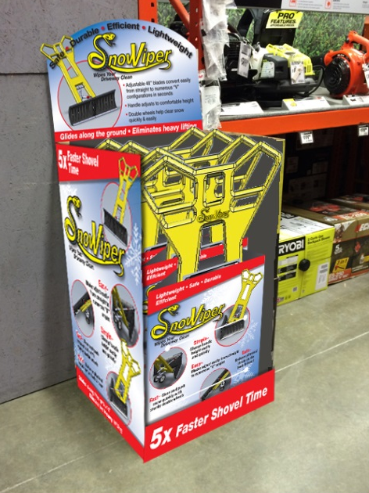
Product Packaging
Each SnowViper will be packaged in a cardboard box with the handle exposed
Sets of SnowViper boxes will be displayed in advertisement boxes
Notes:
Rick Speaking

Slide 18
Product Promotion
Retail – Mass and Specialty
Live Shopping Networks – QVC, HSN, Evine
Online – Website, other E-Commerce Platforms
Trade Shows
Licensing and Private Label
Notes:
Brian Speaking

Slide 19
Marketing Strategy
Social Media: To leverage influencer fan bases and create dynamic campaigns to engage customers
Online Marketing: To focus on advertising, SEO, Content Marketing, Social Media
Public Relations: To engage targeted outreach to print, broadcast, online & bloggers
Advertising: To support marketing efforts with select traditional advertising including potential outdoor, print, radio & television
Short Form Infomercial: To support and drive retail sales with short form spots
Special Events: To create events to bring SnowViper to life
Notes:
Brian Speaking

Slide 20
Basic Business Structure
SnowViper Patents LLC
SnowViper LLC
Holds SnowViper Patents
Produces, Markets, and Sells SnowVipers
Peter Masi
Frank Faraci
Joseph Faraci Sr.
Peter Masi
Frank Faraci
Joseph Faraci Sr.
Friends, Family, & Investors
Notes:
Bob Speaking

Slide 21
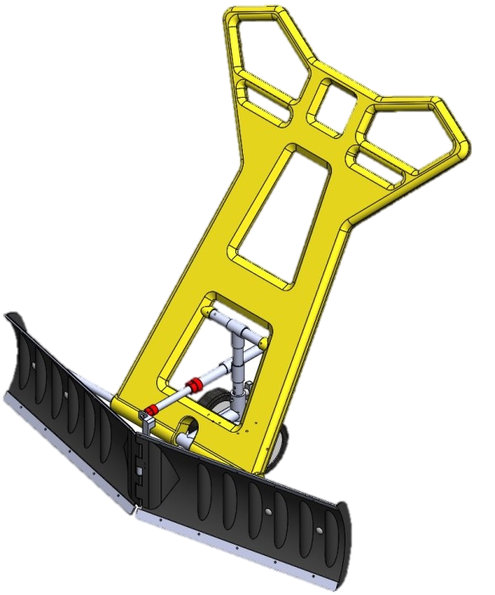

Revenue Flow
SnowViper Sales
Revenue
SnowViper LLC.
(return on investments)
SnowViper Patent LLC.
(Patent Licensing Fee)
Notes:
Bob Speaking

Slide 22
We are proposing a 5 year Note
A financial security
Essentially a loan from investors to the note issuer
(in this case SnowViper LLC.)
Carries a “coupon” which uses percentages to describe the amount of total interest to be paid until maturity
Similar to bonds in that they are:
  Make regular interest payments
  Have specific terms until maturity
Notes:
Bob Speaking

Slide 23
SnowViper LLC. Note
5 year Note
20% coupon
Total raise to be in the area of $300,000
Quarterly interest payments
Notes:
Bob Speaking

Slide 24
SnowViper LLC. Note
SnowViper has option to pay off note early, avoiding any further interest payments
  If this option is exercised, investors will have the right to buy into the LLC. at a preferred valuation for a limited number of units.
Investors have option to forgo interest payments and receive units in SnowViper LLC., which come with a lifetime royalty
If the note is taken to maturity, the initial investment group will be offered units at a preferred valuation. These units will come with a royalty for 5 years only, sunseting in the last 3 years.
Notes:
Bob Speaking

Slide 25
General Use of Funds
Secure lease of patent rights to produce and sell the SnowViper
Produce the molds of blades and handle of SnowViper which will allow for cost-effective mass production
Complete safety testing of finished product
Product Marketing and Trade Shows
Produce and distribute the first run of SnowViper sold

Slide 26
Thank you for joining us
at the unVeiling of
the most innovative
snow removal product ever!
Brought to you by: Peter Masi, Frank Faraci, and Joe Faraci
Guest Presenters: Brian Harrington, Rick Harrington,
Bob Iaccino and Margaret Perrotta

